Slide 1


Project name: ADC Resolution vs. Sensorless Motor Control Performance Team members: Tamara Basfar, Cristian Ornelas, Tyler Hawkins, John King
Sponsors: Texas Instruments(Kevin Allen)

Slide 2
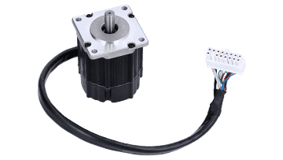
Problem Statement
Conventional motor systems usually depend on sensored motor control to supply feedback, but these sensors can malfunction, particularly in unfavorable environments. There is an increasing need to simplify systems, improve dependability, and decrease cost expenses. On the other hand, with sensorless motor control, the drawback is that there is a lack of feedback at low speeds during startup.
Solution?
Notes:
Christian
2 minute

Slide 3
Project Description
Solution proposal: Develop software for sensorless motor control on one of TI’s newest c2000 devices with enhanced features, and conduct an array of tests on the software, as well as software given by TI, to determine what set of sensorless control parameters are most effective.
Notes:
Case
2 minute

Slide 4
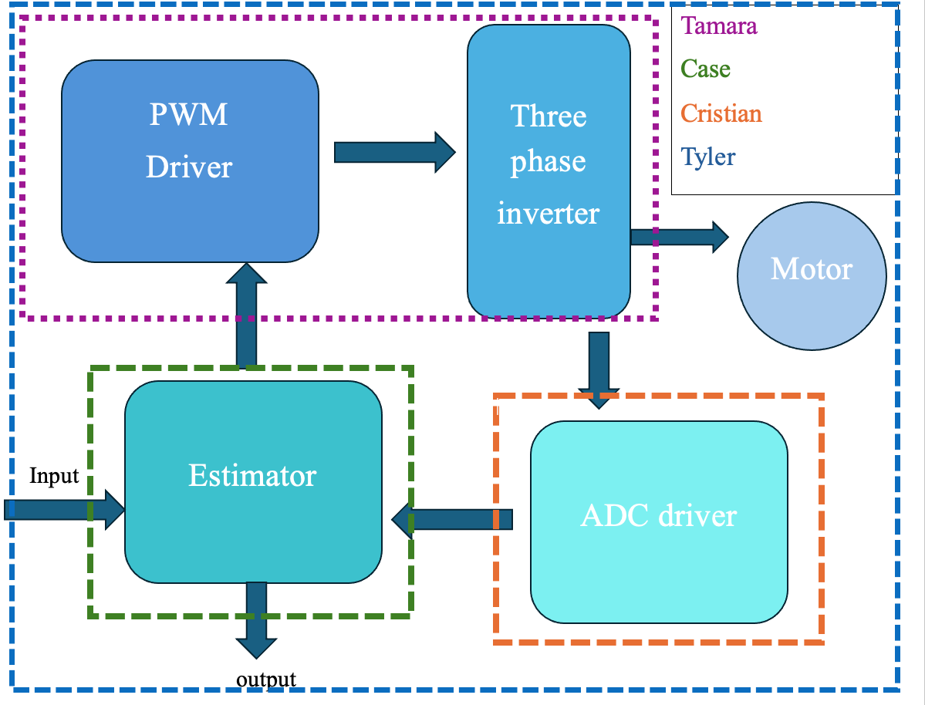
Diagram of subsystems and interface
Notes:
Tyler->Cristian->Case/Tamara

Slide 5
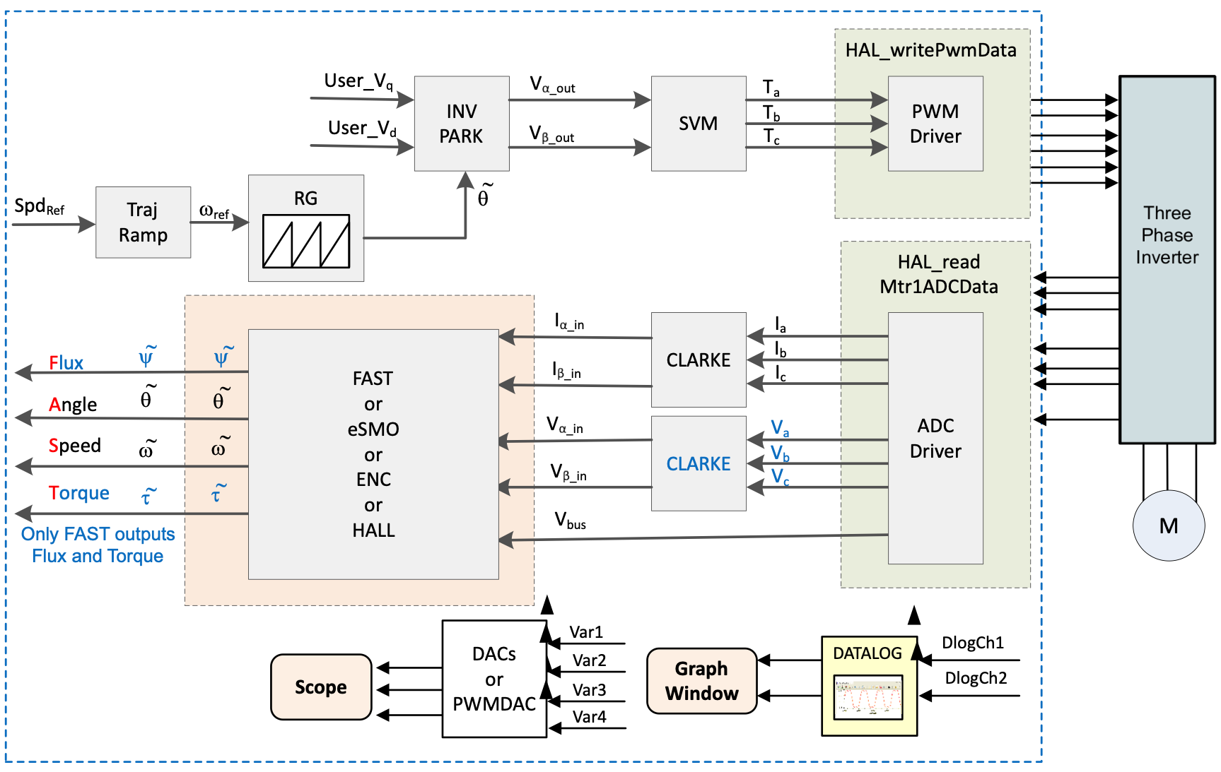

Slide 6
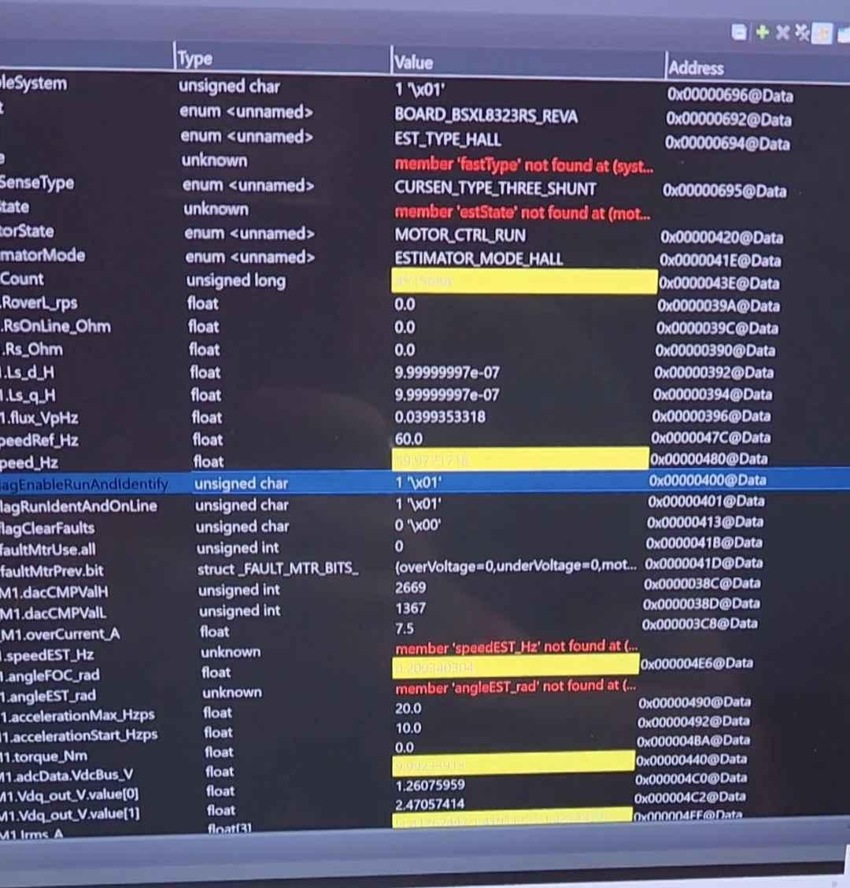
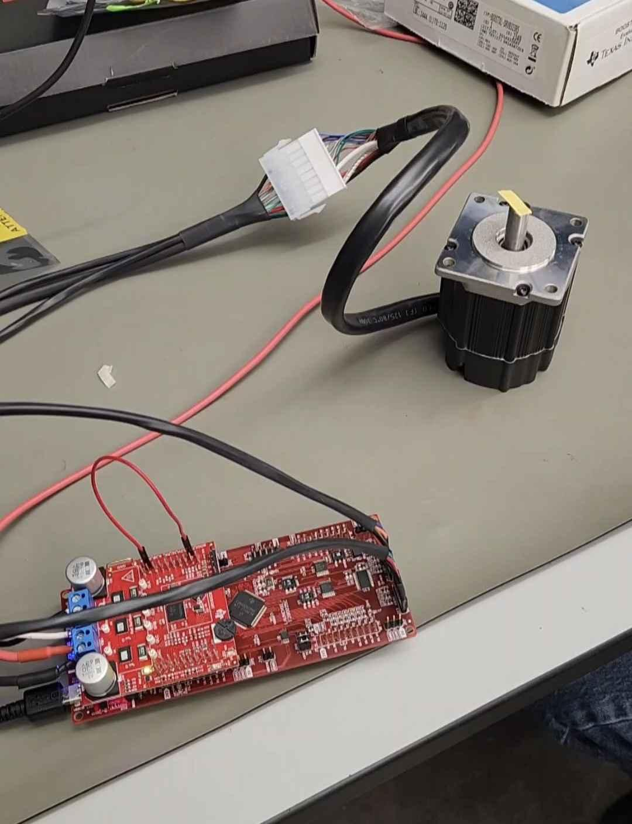
-Solution Porting-
Tyler Hawkins
Accomplishments | Ongoing progress/problems and plans
Able to run solution on older F28002x board Souldered capacitors for sensorless testing on old board Updated projectspec file Updated cmd linker files Updated hall.c file Updated hall.h file Full system build successful | Error fixes and debugging Testing solution on f28p65x board Adding DRV8300 driver board support Add sysconfig support

Slide 7
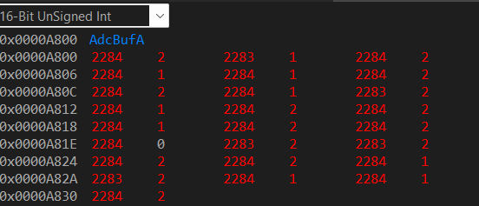
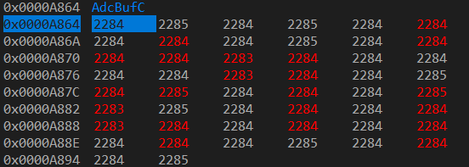
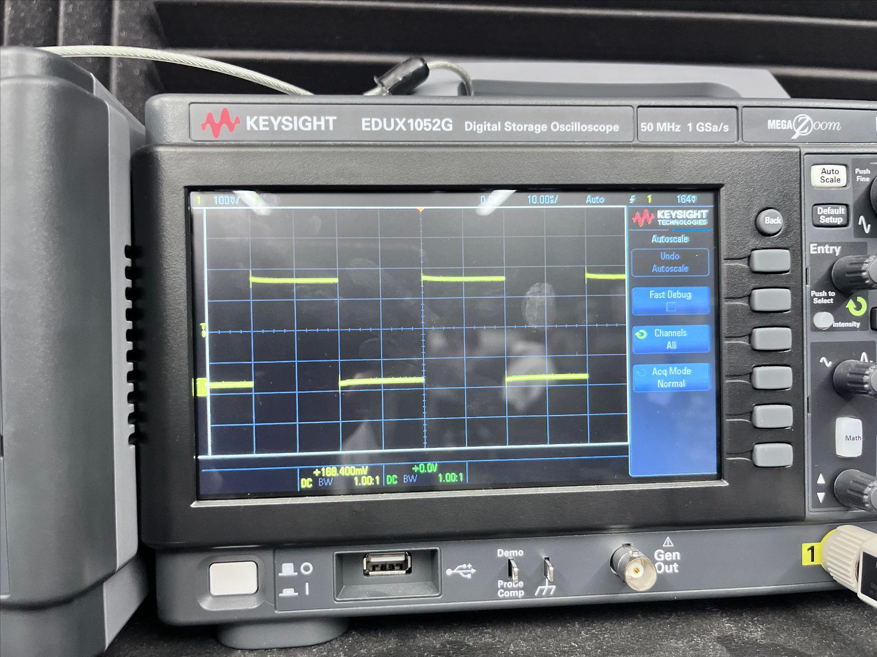
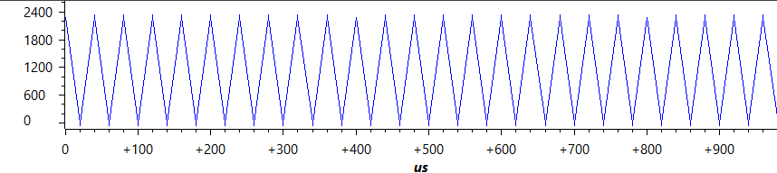
-ADC Driver-
Cristian Ornelas
Accomplishments | Ongoing progress/problems and plans
Create 3 ADCs modules that uses a PWM module to simultaneously convert and output data | Sysconfig. Utilize LED’s on the f28p65x Clean up code

Slide 8
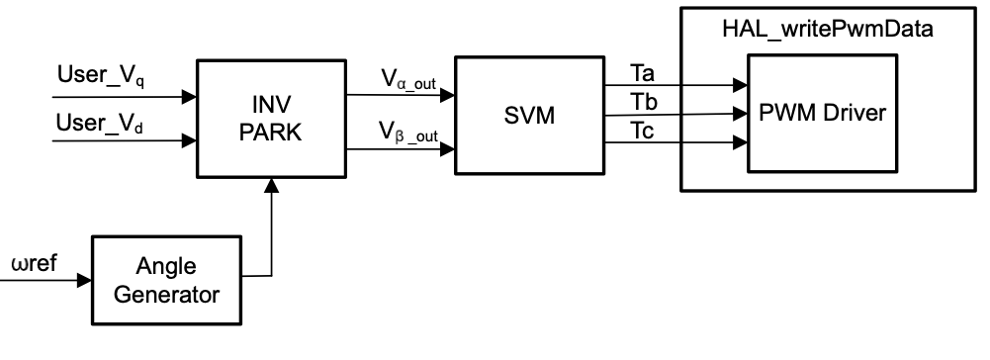
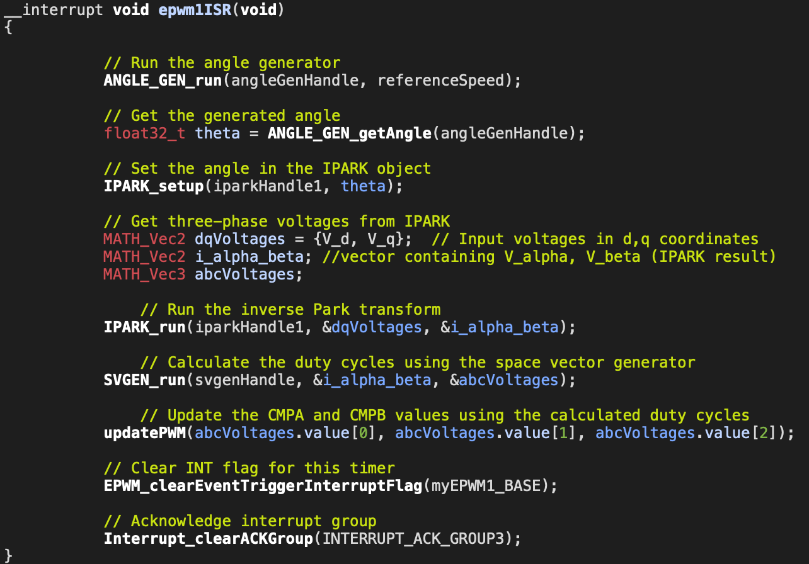
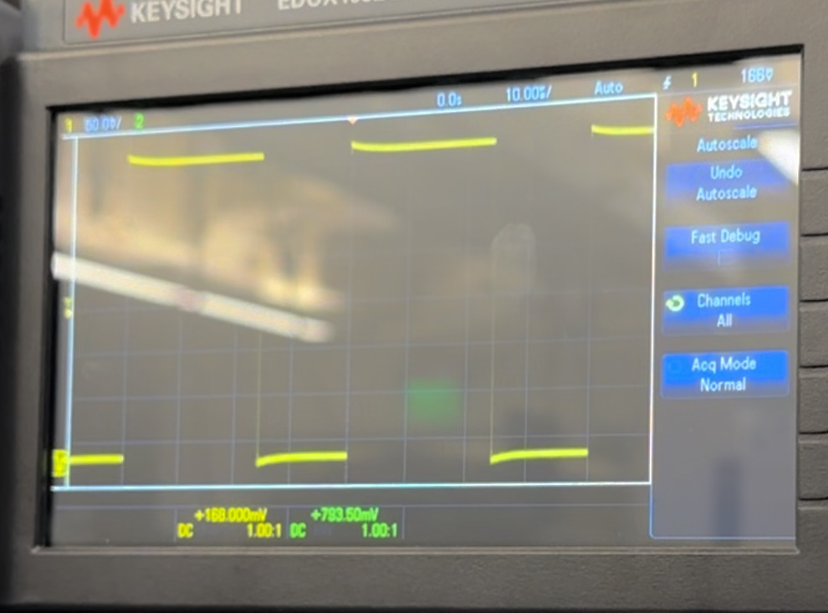
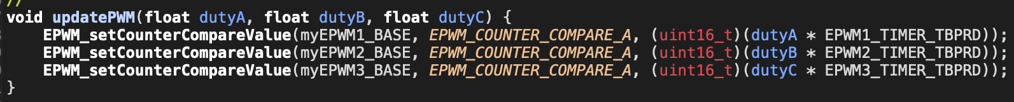
-PWM-
Tamara Basfar
staring with a simple pwm
integrating functions

Slide 9
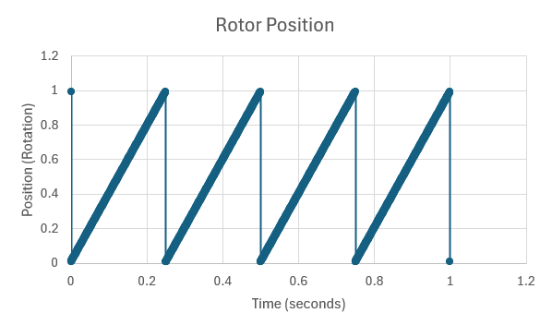
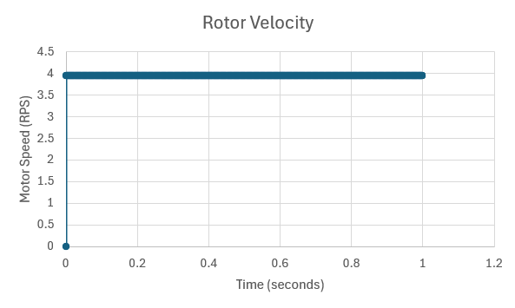
-Estimator-
John Adam Case King
Accomplishments | Ongoing progress/problems and plans
Created Functioning Estimator Code that works under Ideal conditions. | Weed-out final bugs in the mathematics portion of the code. Porting to Launchpad with the help of group members with greater experience.

Slide 10
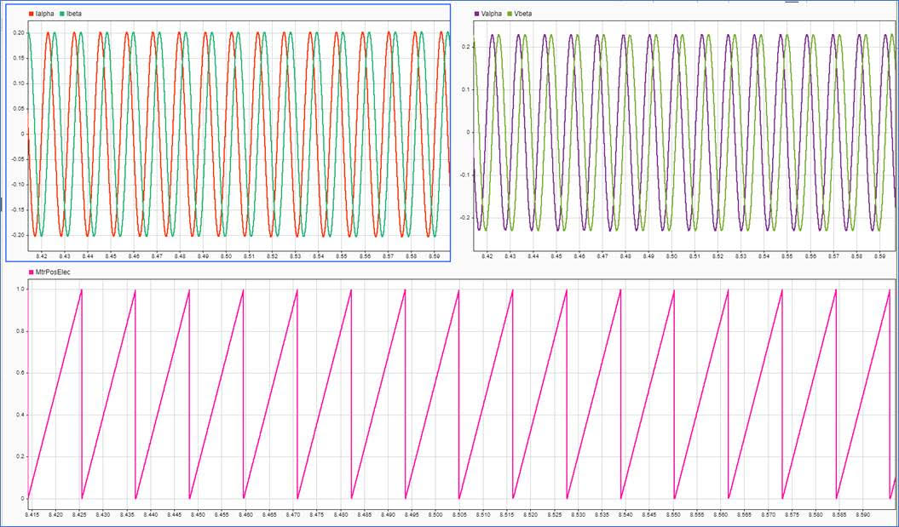
-Estimator-
John Adam Case King

Slide 11
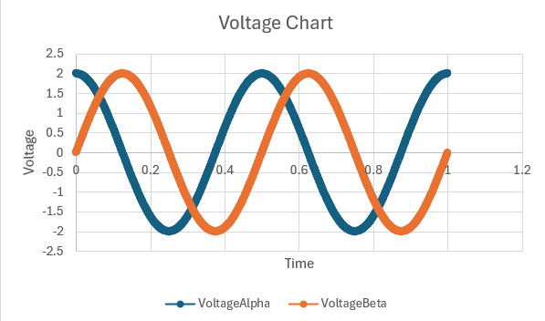
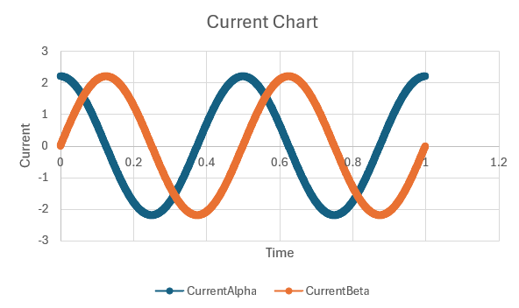
-Estimator-
John Adam Case King

Slide 12
Next steps and challenges
ECEN 404:
Adding support for the DRV8300 Driver Board
Changing ADC resolutions and other parameters to compare performance
Adding Sysconfig support

Slide 13
Validation plan
Task | Specification | Result | Owner
Test individual function Operation | each block function outputs correct data | TESTED | Tamara
Test Estimator Operation | The estimator correctly collects motor information. This is done by comparing with sensored motor outputs |  | case
ADC Driver Operation | ADC Correctly converts Analog signal to digital signal through test cases and plotting | TESTED | Cristian
System Compiling | Full system compile | TESTED | All
Motor control With sensor Operation | The full system of a motor using a sensor operates correctly. Porting existing sensored motor control software onto 02x launch pad successfully. | TESTED | Tyler
SysConfig support | The system correctly operates using the SysConfig IDE |  | Tyler
16 Bit ADC resolution | The system correctly operates using 16-bit ADC resolution |  | Cristian
12 Bit & 16 Bit ADC resolution Support | The system correctly operates using either 12-bit or 16-bit ADC resolutions |  | Cristian
64-bit Floating point operation | The system Correctly Operates using 64-bit Floating Point |  | Tyler
32-bit & 64-bit Floating point operation | The system Correctly Operates using either 32-bit or 64-bit Floating Point |  | Tyler
Test 12 vs 16 Bit performance | Test the accuracy of both 12-bit and 16-bit ADC resolutions when compared to a motor with a sensor |  | All
Test 32-bit & 64-bit Floating point operation | Test the accuracy of both 32-bit and 64-bit ADC Floating point operations when compared to a motor with a sensor |  | All
Test the effectiveness of oversampling | Test the effectiveness of oversampling by comparison to the old system using a sensor(older board did not support oversampling) |  | All
Notes:
Tyler

